Slide 1
ECEG-5193: Algorithm Analysis and Design
Basics of Algorithm Analysis
The running time of a program

Slide 2
Math you need to Review
Summations
Logarithms and Exponents
Proof techniques

Slide 3
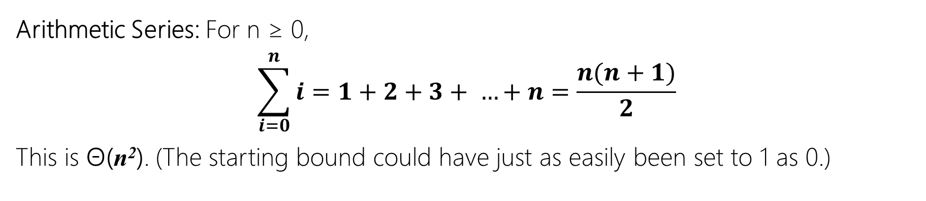
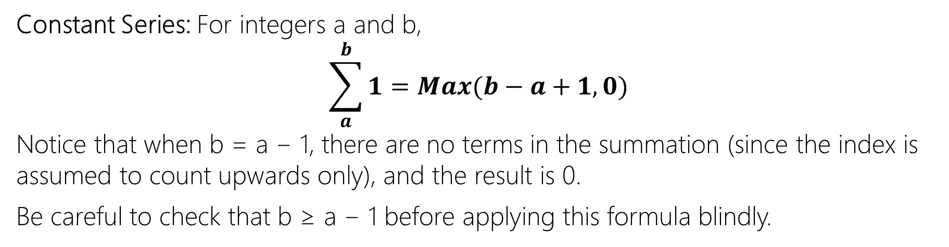
Summations
Constant Series: For integers a and b,
$$\sum_{a}^{b}{1}=Max(b−a+1,0)$$
Notice that when b = a − 1, there are no terms in the summation (since the index is assumed to count upwards only), and the result is 0.
Be careful to check that b ≥ a − 1 before applying this formula blindly.
Arithmetic Series: For n ≥ 0,
$$\sum_{i=0}^{n}{i}=1+2+3+ …+n=\frac{n(n+1)}{2}$$
This is Θ(n²). (The starting bound could have just as easily been set to 1 as 0.)

Slide 4
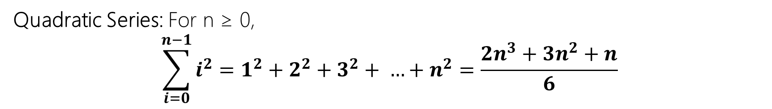
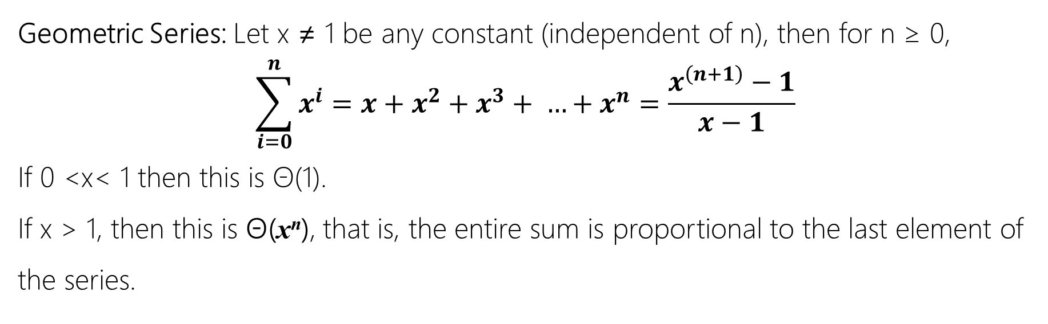
Summations
Geometric Series: Let x ≠ 1 be any constant (independent of n), then for n ≥ 0,
$$\sum_{i=0}^{n}{x^{i}}=x+x^{2}+x^{3}+ …+x^{n}=\frac{x^{\left(n+1\right)}−1}{x−1}$$
If 0 <x< 1 then this is Θ(1).
If x > 1, then this is Θ(x^{n}), that is, the entire sum is proportional to the last element of the series.
Quadratic Series: For n ≥ 0,
$$\sum_{i=0}^{n−1}{i^{2}}=1^{2}+2^{2}+3^{2}+ …+n^{2}=\frac{2n^{3}+3n^{2}+n}{6}$$

Slide 5
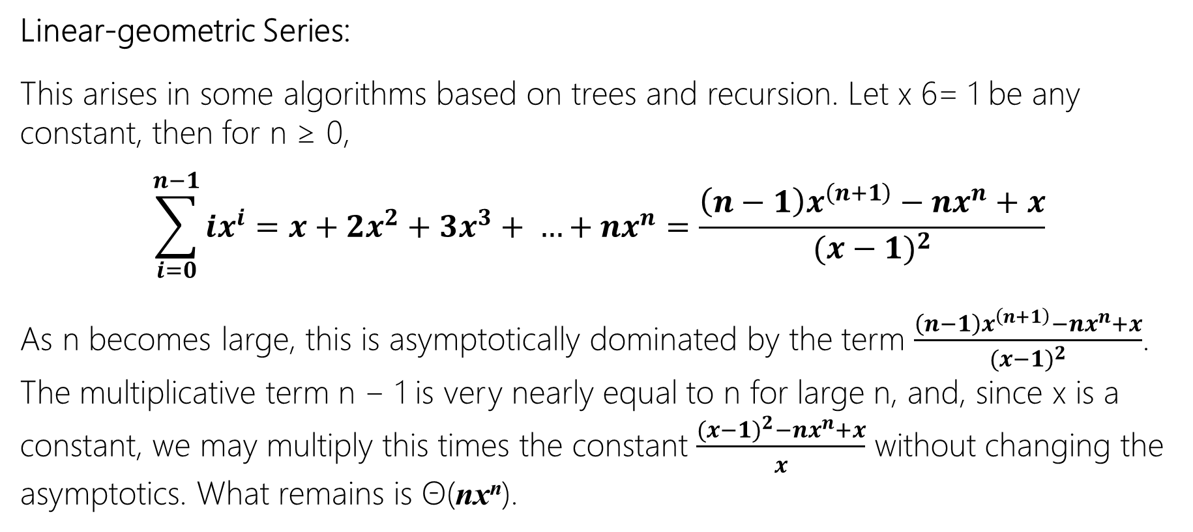
Summations
Linear-geometric Series:
This arises in some algorithms based on trees and recursion. Let x 6= 1 be any constant, then for n ≥ 0,
$$\sum_{i=0}^{n−1}{ix^{i}}=x+2x^{2}+3x^{3}+ …+nx^{n}=\frac{\left(n−1\right)x^{\left(n+1\right)}−nx^{n}+x}{{(x−1)}^{2}}$$
As n becomes large, this is asymptotically dominated by the term $\frac{\left(n−1\right)x^{\left(n+1\right)}−nx^{n}+x}{{(x−1)}^{2}}$. The multiplicative term n − 1 is very nearly equal to n for large n, and, since x is a constant, we may multiply this times the constant $\frac{({x−1)}^{2}−nx^{n}+x}{x}$ without changing the asymptotics. What remains is Θ(nx^{n}).

Slide 6
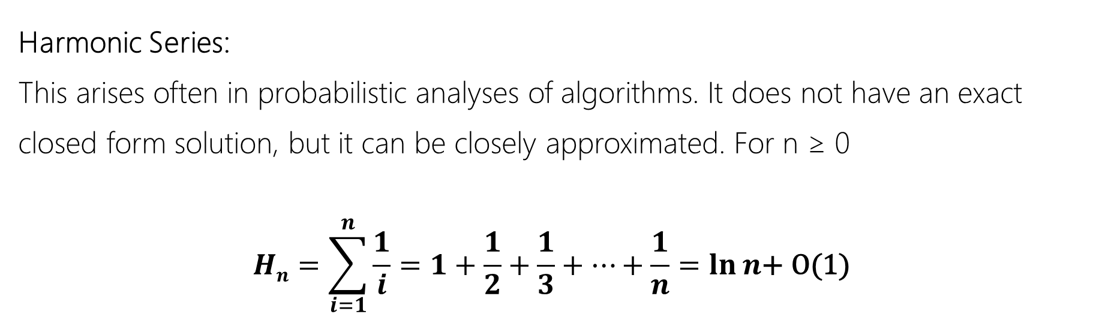
Summations
Harmonic Series:
This arises often in probabilistic analyses of algorithms. It does not have an exact closed form solution, but it can be closely approximated. For n ≥ 0
$$Hn=\sum_{i=1}^{n}{\frac{1}{i}}=1+\frac{1}{2}+\frac{1}{3}+…+\frac{1}{n}=\ln{n\text{+ }\text{O}\text{(1)}}$$

Slide 7
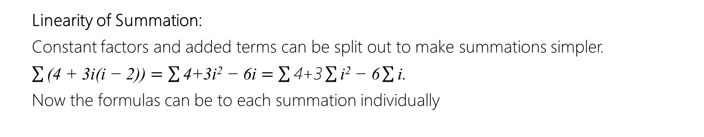
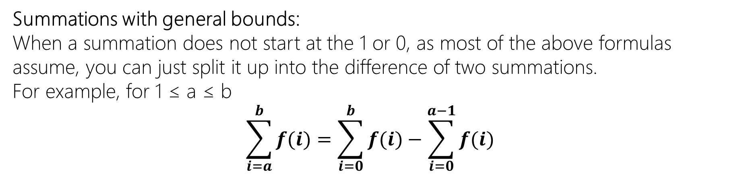
Summations
There are also a few tips to learn about solving summations.
Summations with general bounds:
When a summation does not start at the 1 or 0, as most of the above formulas assume, you can just split it up into the difference of two summations.
For example, for 1 ≤ a ≤ b
$$\sum_{i=a}^{b}{f(i)}=\sum_{i=0}^{b}{f(i)}−\sum_{i=0}^{a−1}{f(i)}$$
Linearity of Summation:
Constant factors and added terms can be split out to make summations simpler. $\sum{\text{(4 + 3}\text{i}\text{(}\text{i}\text{ − 2))}=\sum{\text{4+3}\text{i}\text{2}\text{ − 6}\text{i}}=\sum{\text{4+3}}\sum{\text{i}\text{2}\text{ − 6}}\sum{\text{i}\text{.}}}$
Now the formulas can be to each summation individually

Slide 8
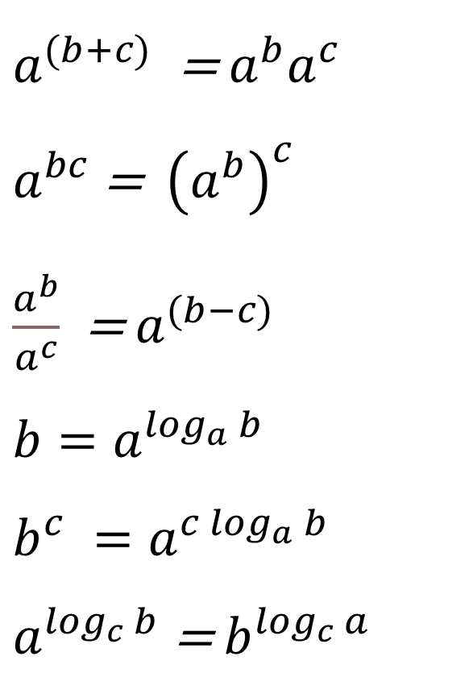
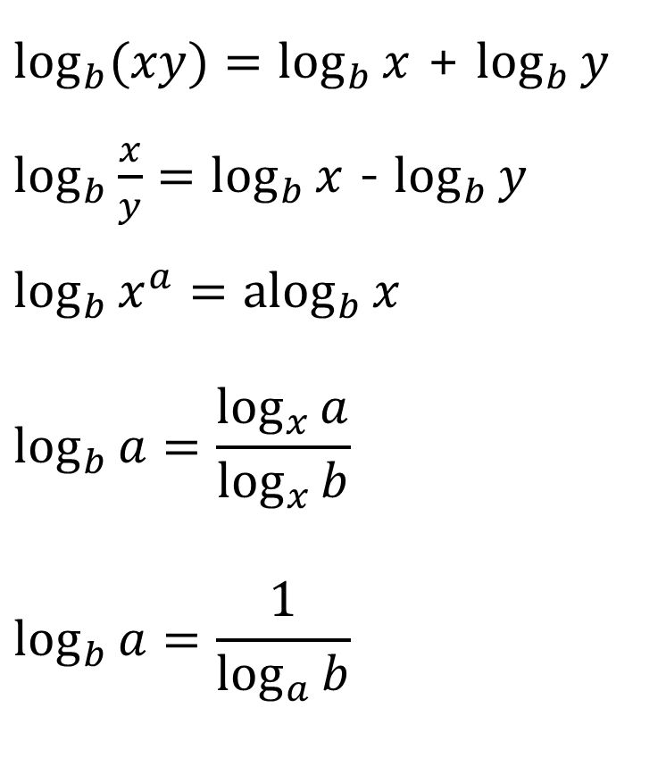
Logarithms and Exponents
$\log_{b}{(xy)}=\log_{b}{x}$ + $\log_{b}{y}$
$\log_{b}{\frac{x}{y}}=\log_{b}{x}$ - $\log_{b}{y}$
$\log_{b}{x^{a}}={alog}_{b}{x}$
$$\log_{b}{a}=\frac{\log_{x}{a}}{\log_{x}{b}}$$
$$\log_{b}{a}=\frac{1}{\log_{a}{b}}$$
$a^{(b+c)}$ = ${a^{b}a}^{c}$
$a^{bc}$= ${\left(a^{b}\right)}^{c}$
$\frac{a^{b}}{a^{c}}$ = $a^{(b−c)}$
$b=a^{\log_{a}{b}}$
$$b^{c} =a^{c\log_{a}{b}}$$
$a^{\log_{c}{b}}$ = $b^{\log_{c}{a}}$

Slide 9
Proofs
Techniques
Proof by Construction.
Proof by Induction.
Proof by Contradiction.

Slide 10
Priori Analysis vs Posteriori Testing
Priori Analysis
Posteriori Testing
Algorithm
Independent of Language
Hardware Independent
Time and Space Function
Program
Language Dependent
Hardware Dependent
Watch time & Bytes

Slide 11
Limitations of Experiments
It is necessary to implement the algorithm, which may be difficult
Results may not be indicative of the running time on other inputs not included in the experiment.
In order to compare two algorithms, the same hardware and software environments must be used

Slide 12
How to Analyze an Algorithm
Time
Space
Network (Data Transfer)
Power Consumption

Slide 13
Algorithm Analysis: Determining performance characteristics
Predicting the resource requirements.
Time, memory, communication bandwidth etc.
Computation time (running time) is of primary concern.
Why analyze algorithms?
Choose the most efficient of several possible algorithms for the same problem.
Is the algorithm optimal (best in some sense)?
– Is something better possible?
Is the best possible running time for a problem reasonably finite for practical purposes?

Slide 14
Running Time
The running time of an algorithm typically grows with the input size.
Average case time is often difficult to determine.
We focus on the worst case running time.
Easier to analyze
Crucial to applications such as games, finance, robotics …

Slide 15
Running Time
Run time expression should be machine-independent.
Use a model of computation or “hypothetical” computer.
Our choice – RAM model (most commonly-used).
Model should be
Simple.
Applicable.

Slide 16
RAM Model
Generic single-processor model.
Supports simple constant-time instructions found in real computers.
Arithmetic (+, –, *, /, %, floor, ceiling).
Data Movement (load, store, copy).
Control (branch, subroutine call).
Run time (cost) is uniform (1 time unit) for all simple instructions.
Memory is unlimited.
Flat memory model – no hierarchy.
Access to a word of memory takes 1 time unit.
Sequential execution – no concurrent operations.

Slide 17
Model of Computation
Should be simple, or even simplistic.
Assign uniform cost for all simple operations and memory accesses. (Not true in practice.)
Question: Is this OK?
Should be widely applicable.
Can’t assume the model to support complex operations.
Ex: No SORT instruction.
Size of a word of data is finite.
Why?

Slide 18
Running Time – Definition
Call each simple instruction and access to a word of memory a “primitive operation” or “step.”
Running time of an algorithm for a given input is
The number of steps executed by the algorithm on that input.
Often referred to as the complexity of the algorithm.

Slide 19
Complexity and Input
Complexity of an algorithm generally depends on
Size of input.
Input size depends on the problem.
Examples: No. of items to be sorted.
No. of vertices and edges in a graph.
Other characteristics of the input data.
Are the items already sorted?
Are there cycles in the graph?

Slide 20
Example
Algorithm Swap(A, B)
O(1)
{
TEMP = A;
A = B;
B = TEMP
}
time
space
1
TEMP =1
1
A =1
1
B =1
f(n) = 3
s(n) = 3 words
O(1)
O(1)

Slide 21
Example
Algorithm DoSomeThing(A, B)
O(1)
{
TEMP = A*A + B*B;
A = Temp /B;
B = TEMP /A
}
1 unit of time << constant time>>
1
1
f(n) = 3

Slide 22
Example: Counter
Algorithm SUM(A, n)
O(n)
{
S = 0;
for(i = 0;i < n; i++);
S+= A[i]
Return S;
}
space
1
n
i = 1
n + 1
n =1
n +1
1
n
A =n
1
S =1
f(n) = 2n + 3
s(n) = n+3
O(n)
O(n)

Slide 23
Example: Matrix Addition
Algorithm MATRIX_ADD(A, B, n)
O(n²)
{
for(i = 0;i < n; i++)
for(j = 0;j < n; j++)
C[i,j]= A[i,j] + B[i,j]
}
space
i = 1
n +1
j = 1
n =1
n(n + 1)
A = n²
B = n²
n * n
C = n²
f(n) = 2n² + 2n + 1
s(n) = 3n² + 3
O(n²)
O(n²)

Slide 24
Example: Matrix Multiplication
Algorithm MATRIX_MUL(A, B, n)
S(n)=O(n²)
T(n)=O(n³)
{
for(i = 0;i < n; i++)
for(j = 0;j < n; j++)
C[i,j]= 0
for(k = 0;k < n; k++)
C[i,j]+= A[i,k] * B[k,j]
}
space
n +1
i = 1
j = 1
n*(n + 1)
k = 1
n * n
n =1
A = n²
n * n ( n + 1)
B = n²
n * n * n
C = n²
s(n) = 3n² + 4
f(n) = 2n³ + 3n² + 2n + 1
O(n³)
O(n²)

Slide 25
Time Complexity
f(n)
for(i = 0;i < n; i++)
statement;
n
O(n)
for(i = n;i > 0; i--)
statement;
n
O(n)
for(i = 0;i < n; i = i+2)
statement;
^{n}/₂
O(n)
for(i = 0;i < n; i = i+1000)
statement;
^{n}/₁₀₀
O(n)

Slide 26
Time Complexity
for(i = 0;i < n; i++)
for(j = 0;j < n; j++)
statement;
O(n²)
for(i = 0;i < n; i++)
for(j = 0;j < i; j++)
statement;
O(n²)
for(i = 0;i < n; i++)
for(j = 0;j < n; j++)
statement;
O(n)

Slide 27
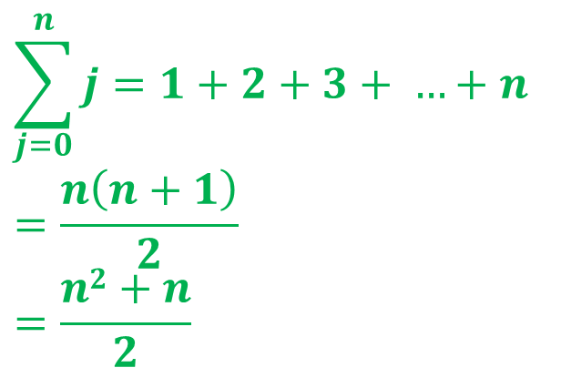
Time Complexity
for(i = 0;i < n; i++)
for(j = 0;j < n; j++)
statement;
O(n²)
for(i = 0;i < n; i++)
for(j = 0;j < i; j++)
statement;
O(n²)
$$\sum_{j=0}^{n}{j}=1+2+3+ …+n$$
$$=\frac{n\left(n+1\right)}{2}$$
$$=\frac{n2+n}{2}$$
i:
0
1
2
3
…
n-1
n
j:
0
1
2
3
n-1
n

Slide 28
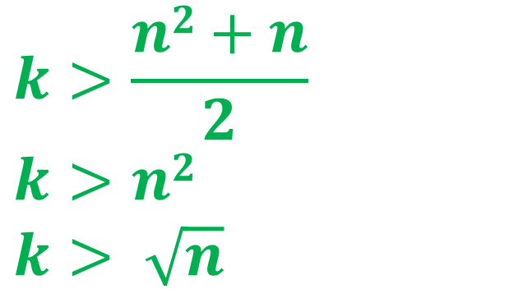
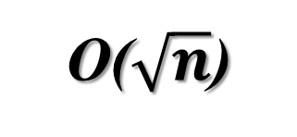
Time Complexity
x = 0;
for(i = 1; x < n; i++)
x = x + i;
O($\sqrt{n}$)
i:
1
2
3
4
…
n-1
n
x:
1
3
6
10
,,,
k
$$k>\frac{n2+n}{2}$$
$$k>n2$$
$$k> \sqrt{n}$$
1
1+2+
1+2+
3+
1+2+
3+
4
1+2+
+
:
+
k

Slide 29
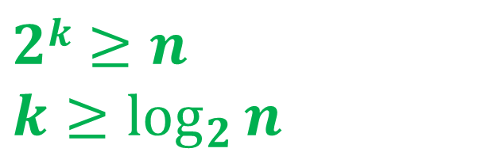
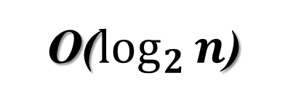
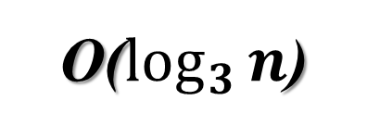
Time Complexity
for(i = 1;i < n; i = i*2)
statement;
O($\log_{2}{n}$)
$$2k≥n$$
$$k≥\log_{2}{n}$$
i:
1
2
2²
2³
…
2^{k-1}
2^{k}
for(i = 1;i < n; i = i*3)
statement;
O($\log_{3}{n}$)

Slide 30
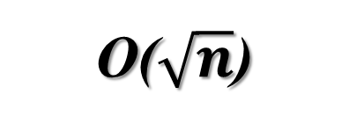
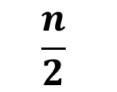
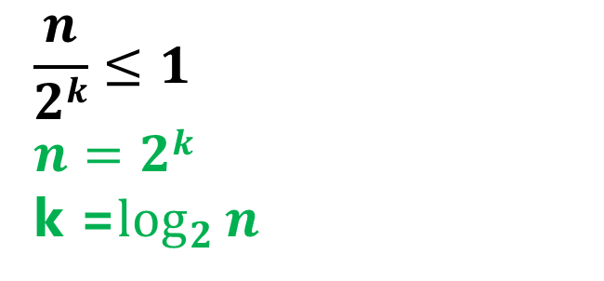
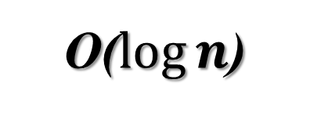
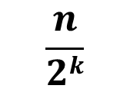
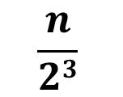
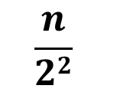
Time Complexity
for(i = n; i > 1; i = i/2)
statement;
O($\log{n}$)
i:
n
$$\frac{n}{2}$$
$$\frac{n}{22}$$
$$\frac{n}{23}$$
…
$$\frac{n}{2k}$$
$$\frac{n}{2k}≤1$$
$$n=2k$$
k =$\log_{2}{n}$
for(i = n; i*i < 1; i = i/2)
statement;
O($\sqrt{n}$)

Slide 31
Types of Functions
O(1)
f(n) = 2 or f(n) = 5 or f(n) = 7000 or …
O(log n)
O(n)
f(n) = 2n or f(n) = 5n+3 or f(n) = $\frac{n}{5000}+6$ or …
O(n²)
O(n³)
O(2^{n})
O(3^{n})
O(n^{n})

Slide 32
Comparison of Algorithms
Complexity function can be used to compare the performance of algorithms.
Algorithm A is more efficient than Algorithm B for solving a problem, if the complexity function of A is of lower order than that of B.
Examples:
Linear Search – Θ(n) vs. Binary Search – Θ(lg n)
Insertion Sort – Θ(n²) vs. Quick Sort – Θ(n lg n)

Slide 33
Hierarchy of functions
n√n
n
³√n
nlog₂n
√n
log₂n
1
2^{n}
n²
n!
n^{n}
n³

Slide 34
Hierarchy of functions
1
n√n
n
³√n
nlog₂n
√n
log₂n
2^{n}
n²
n!
n^{n}
n³

Slide 35
Hierarchy of functions
1, log₂n
n√n
n
³√n
nlog₂n
√n
2^{n}
n²
n!
n^{n}
n³

Slide 36
Hierarchy of functions
1, log₂n, ³√n
n√n
n
nlog₂n
√n
2^{n}
n²
n!
n^{n}
n³

Slide 37
Hierarchy of functions
1, log₂n, ³√n, √n
n√n
n
nlog₂n
2^{n}
n²
n!
n^{n}
n³

Slide 38
Hierarchy of functions
1, log₂n, ³√n, √n, n
n√n
nlog₂n
2^{n}
n²
n!
n^{n}
n³

Slide 39
Hierarchy of functions
1, log₂n, ³√n, √n, n, nlog₂n
n√n
2^{n}
n²
n!
n^{n}
n³

Slide 40
Hierarchy of functions
1, log₂n, ³√n, √n, n, nlog₂n, n√n
2^{n}
n²
n!
n^{n}
n³

Slide 41
Hierarchy of functions
1, log₂n, ³√n, √n, n, nlog₂n, n√n, n²
2^{n}
n!
n^{n}
n³

Slide 42
Hierarchy of functions
1, log₂n, ³√n, √n, n, nlog₂n, n√n, n², n³
2^{n}
n!
n^{n}

Slide 43
Hierarchy of functions
1, log₂n, ³√n, √n, n, nlog₂n, n√n, n², n³, 2^{n}
n!
n^{n}

Slide 44
Hierarchy of functions
1, log₂n, ³√n, √n, n, nlog₂n, n√n, n², n³, 2^{n}, n!, n^{n}
Each one is Big-Oh of any function to its right

Slide 45
Order of growth
Principal interest is to determine
how running time grows with input size – Order of growth.
the running time for large inputs – Asymptotic complexity.
In determining the above,
Lower-order terms and coefficient of the highest-order term are insignificant.
Ex: In 7n⁵+6n³+n+10, which term dominates the running time for very large n?
Complexity of an algorithm is denoted by the highest-order term in the expression for running time.
Ex: Ο(n), Θ(1), Ω(n²), etc.
Constant complexity when running time is independent of the input size – denoted Ο(1).
Linear Search: Best case Θ(1), Worst and Average cases: Θ(n).

Slide 46
Why Order of Growth Matters?
Computer speeds double every two years, so why worry about algorithm speed?
When speed doubles, what happens to the amount of work you can do?
What about the demands of applications?

Slide 47
Effect of Faster Machines
Comparison of Algorithms | Hardware Speed (million operations per second) |  | Gain
 | 1 M | 2M
Ο(n²) | 1000 | 1414 | 1.414
O(n lgn) | 62700 | 118600 | 1.9
Higher gain with faster hardware for more efficient algorithm.
Results are more dramatic for more higher speeds.

Slide 48
Loop Invariant
Logical expression with the following properties.
Holds true before the first iteration of the loop – Initialization.
If it is true before an iteration of the loop, it remains true before the next iteration – Maintenance.
When the loop terminates, the invariant ― along with the fact that the loop terminated ― gives a useful property that helps show that the loop is correct – Termination.
Similar to mathematical induction.
Are there differences?

Slide 49
Correctness Proof of Linear Search
Use Loop Invariant for the while loop:
At the start of each iteration of the while loop, the search key is not in the subarray A[1..i-1].
If the algm. terminates, then it produces correct result.
Initialization.
Maintenance.
Termination.
Argue that it terminates.
LinearSearch(A, key)
1 i ← 1
2 while i ≤ n and A[i] != key
3 do i++
if i ≤ n
then return true
else return false

Slide 50
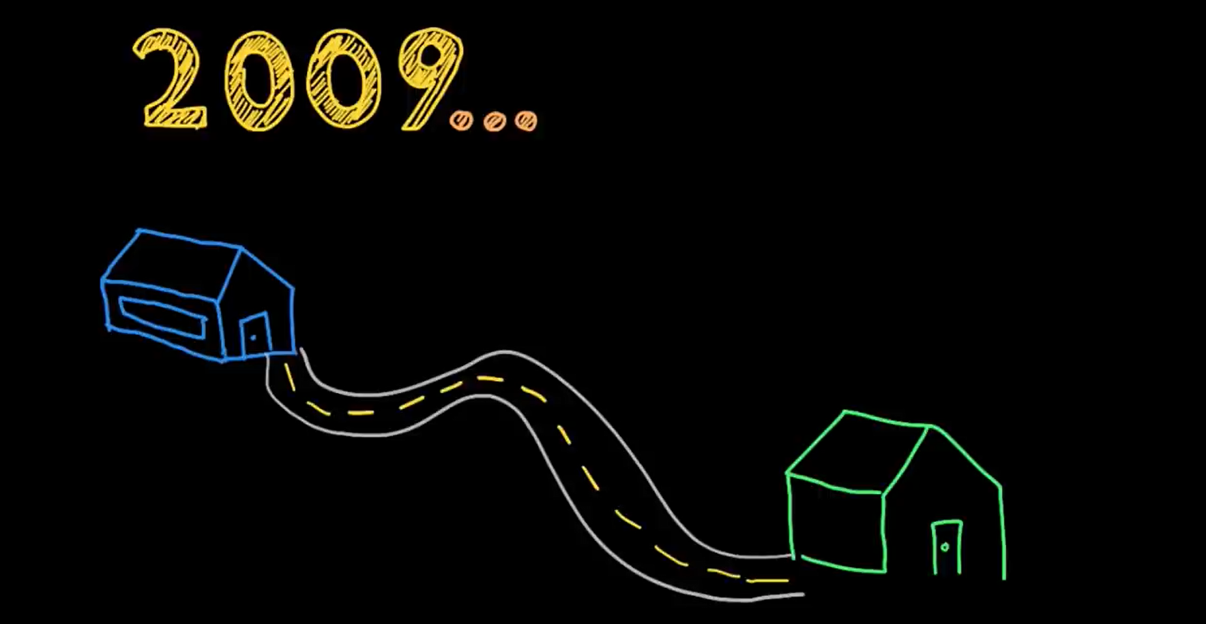



Pigeon beat the internet!
50 miles.
Notes:
In 2009 South Africa. Very Slow Internet Connection

Slide 51
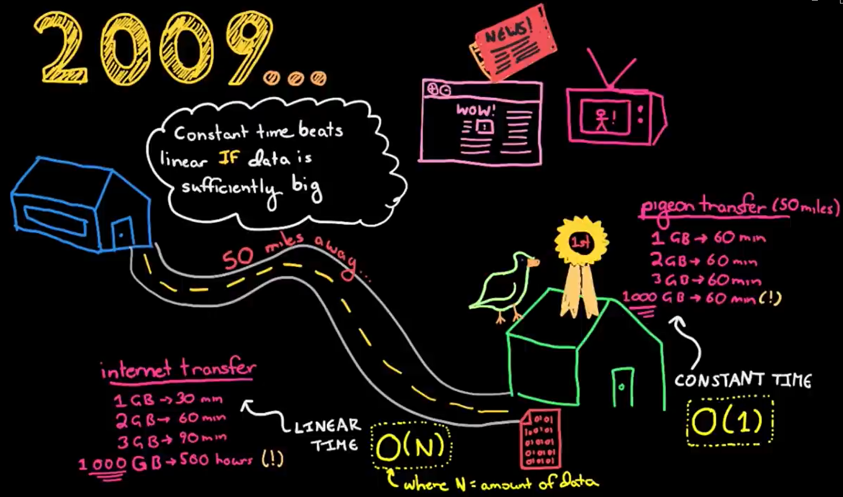

Slide 52
Running Time: upper bounds vs lower bounds
The running time depends on the input
Parameterize the running time by the size of the input.
For example, short sequences are easier to sort than long ones.
Generally, we seek upper bounds on the running time
because everybody likes a guarantee.
Notes:
an already sorted sequence is easier to sort.

Slide 53
Machine-independent time
What is insertion sort’s worst-case time?
• It depends on the speed of our computer,
• relative speed (on the same machine),
• absolute speed (on different machines).
BIG IDEA:
• Ignore machine-dependent constants.
• Look at growth of T(n) as n → ꝏ
“Asymptotic Analysis”

Slide 54
Theoretical Analysis
Uses a high-level description of the algorithm instead of an implementation
Characterizes running time as a function of the input size, n.
Takes into account all possible inputs
Allows us to evaluate the speed of an algorithm independent of the hardware/software environment

Slide 55
Next
Big O, Big Omega and Theta Notations
Little O, Little Omega Notations

